Slide 1

Introduction to React E1
Bee Plus | Thisura Hettiarachchi

Slide 2
Webinar Series Workflow
Part 1 - React Introduction and Setup
Part 2 – React Form and Event Handling
Part 3 – CSS Implementation
Part 4 – Editing To-do Items
Part 5 – React State in Local Storage
Part 6 – Lifecycle Methods
Part 7 – React Hooks
Part 8 – SVG icons
Part 9 – React router
Part 10 – Hamburger menu
Part 11 – Deployment
Part 12 – Q&A

Slide 3
Prerequisites
Basic understanding of HTML and CSS.
JavaScript fundamentals (object, array, conditionals etc).
Familiarity with JavaScript ES6 features (class syntax, arrow functions, object destructuring etc).

Slide 5
Part 1 React Introduction and Setup

Slide 6
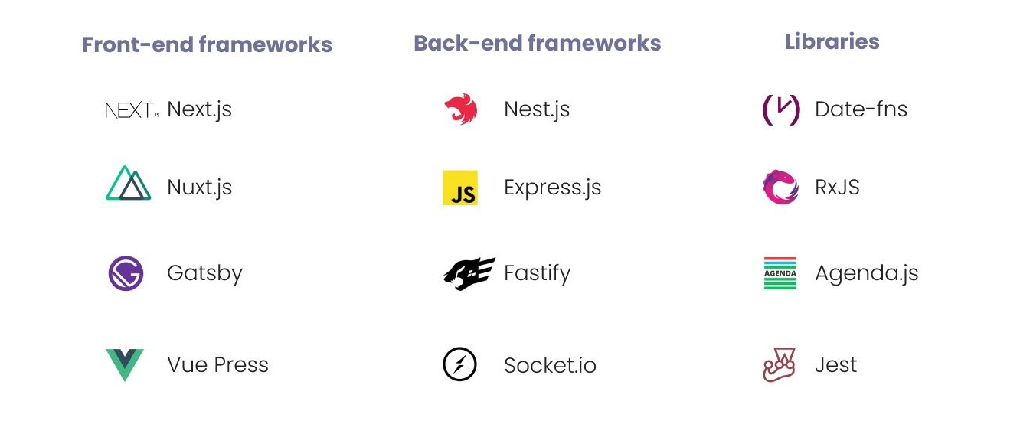

What is React?
Notes:
Terminology - the body of terms used with a particular technical application in a subject of study, profession, etc.

Slide 7
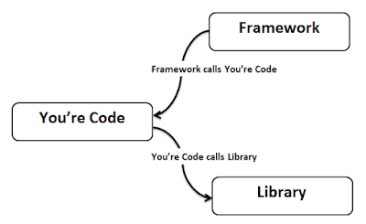
Framework vs Library

Slide 8

JavaScript ?
Notes:
JavaScript is a scripting or programming language that allows you to implement complex features on web pages

Slide 9

“A JavaScript Library For Building User Interfaces”.

Slide 10

Why is React?

Slide 11
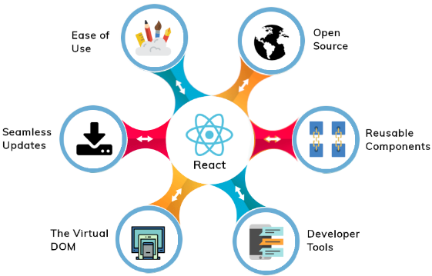

Slide 12
Virtual DOM
Diffing
Reconciliation
Batched update

Slide 13
Developer Tools
The React Devtools extension for Chrome and Firefox lets you inspect a React component tree with your browser’s developer tools.

Slide 14
JSX – JavaScript XML
<!DOCTYPE html>
<html lang="en">
<head>
<title>React Tutorial</title>
<script src="https://unpkg.com/react@16/umd/react.development.js"></script>
<script src="https://unpkg.com/react-dom@16/umd/react-dom.development.js"></script>
<script src="https://cdnjs.cloudflare.com/ajax/libs/babel-standalone/6.26.0/babel.js"></script>
</head>
<body>
<div id="root"></div>
<script type="text/babel">
const element = <h1>Hello from React</h1>;
console.log(element);
</script>
</body>
</html>

Slide 15
Environment Set up
Nodejs
https://nodejs.org/en/
Code Editor / IDE
https://code.visualstudio.com/

Slide 16
Create React App
npx create-react-app react-todo-app

Slide 17
Toolchain
A package manager - Yarn or npm
It lets you take advantage of a vast ecosystem of third-party packages, and easily install or update them.
A bundler - webpack or Parcel
It lets you write modular code and bundle it together into small packages to optimize load time.
A compiler - Babel
It lets you write modern JavaScript code that still works in older browsers.

Slide 18
Toolchain variations
learning React or creating a new single-page app
Create React App
server-rendered website with Node.js
Next.js
static content-oriented website
Gatsby

Slide 19
Let’s create the file. In the src folder, create an index.js file and add the following code:
import React from "react"
import ReactDOM from "react- dom"
const element = <h1>Hello from Create React App</h1>
ReactDOM.render(element, document.getElementById("root"))

Slide 20

Components

Slide 21
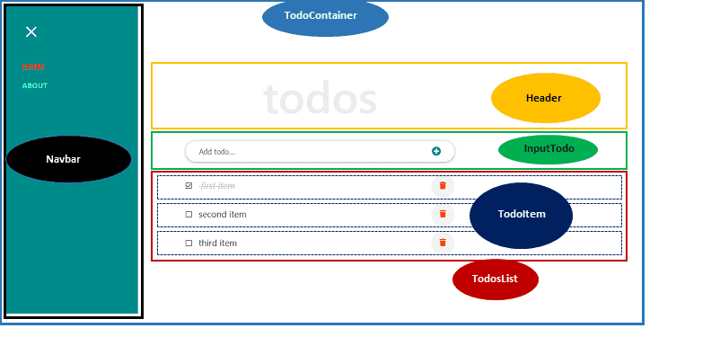

Slide 22
Components
Class Component
Functional Component

Slide 23
Next, add the following code in the parent component file, TodoContainer.js and save it:
import React from "react"
class TodoContainer extends React.Component {
render() {
return (
<div>
<h1>Hello from Create React App</h1>
<p>I am in a React Component!</p>
</div>
)
}
}
export default TodoContainer

Slide 24
Also, go inside the index.js file and update it so it looks like so:
import React from "react"
import ReactDOM from "react- dom“
//component file
import TodoContainer from "./components/TodoContainer"
ReactDOM.render(<TodoContainer />, document.getElementById("root"))

Slide 25
Strict Mode

Slide 26
To enable it, we simply wrap our component with <React.StrictMode> like so:
import React from "react"
import ReactDOM from "react-dom"
//component file
import TodoContainer from "./components/TodoContainer"
ReactDOM.render(
<React.StrictMode>
<TodoContainer />
</React.StrictMode>,
document.getElementById("root")
)

Slide 27
Manage Data with components

Slide 28
Props and State
Props are used to pass data
state is for managing data
Notes:
Props is short for properties, and they are used to pass data between React components. React’s data flow between components is uni-directional (from parent to child only).

Slide 29
State
State is a plain JavaScript object used by React to represent an information about the component's current situation

Slide 30
State lifting

Slide 31
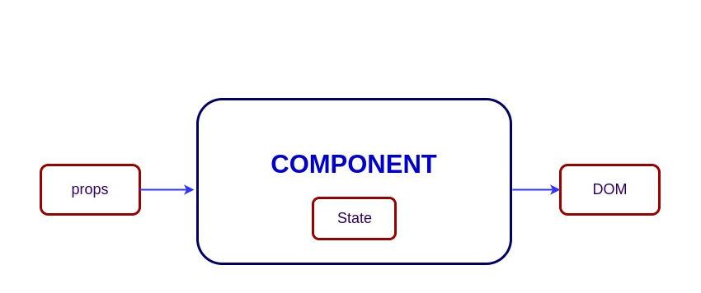
Props

Slide 32
Context API
The context API in React allows every component in the component tree to have access to consume data without having to manually pass props down to it. The advantage here is that you will get to cut out "middleman" components. Meaning only the component that needs the data would know about it.

Slide 33
So, add the following code just above the render() method in the TodoContainer.js file:
state = {
todos: [
{
id: 1,
title: "Setup development environment",
completed: true
},
]
};

Slide 34
Still in the file, update the render() method so it looks like this:
render() {
return (
<ul>
{this.state.todos.map(todo => (
<li>{todo.title}</li>
))}
</ul>
);
}

Slide 35
After that, open the TodoContainer.js file and modify the render() method so it looks like this:
render() {
return (
<div>
<TodosList todos={this.state.todos} />
</div>
);
}

Slide 36
you must import the component. So, add this at the top of the TodoContainer.js file
import TodosList from "./TodosList";

Slide 37
So let’s update the TodosList.js file so it looks like this:
import React from "react"
class TodosList extends React.Component {
render() {
return (
<ul>
{this.props.todos.map(todo => (
<li>{todo.title}</li>
))}
</ul>
)
}
}
export default TodosList

Slide 38
Next, import the component in the TodosList.js file using this line:
import TodoItem from "./TodoItem";

Slide 39
After that, replace the <li> element in the map() method with this line:
<TodoItem key={todo.id} todo={todo} />

Slide 40
So, let’s update the TodoItem.js file so it looks like this:
import React from "react"
class TodoItem extends React.Component {
render() {
return <li>{this.props.todo.title}</li>
}
}
export default TodoItem

Slide 41
Components
Class Component
Functional Component

Slide 42
Functional Component
This is straight forward. So, add the following code in the Header.js file:
import React from "react"
const Header = () => {
return (
<header>
<h1>todos</h1>
</header>
)
}
export default Header

Slide 43
Save the file. Next, go inside the TodoContainer component and import the file in the top like so:
import Header from "./Header"
render() {
return (
<div>
<Header />
<TodosList todos={this.state.todos} />
</div>
);
}

Slide 44
Class-Based Component => Function Component
In the TodoItem.js file, replace the code with the following:
import React from "react"
function TodoItem(props) {
return <li>{props.todo.title}</li>
}
export default TodoItem

Slide 45
TodoItem.js
import React from "react"
class TodoItem extends React.Component {
render() {
return <li>{this.props.todo.title}</li>
}
}
export default TodoItem
import React from "react"
function TodoItem(props) {
return <li>{props.todo.title}</li>
}
export default TodoItem

Slide 46
Part 2 React Form and Event Handling

Slide 47
Open the TodoItem.js file and add the checkbox input just before the title in the li element.
return (
<li>
<input type="checkbox" /> {this.props.todo.title}
</li>
)

Slide 48
Controlled Component

Slide 49
So let’s update the input tag in the TodoItem.js file to include the handler
<input
type="checkbox"
checked={this.props.todo.completed}
onChange={() => console.log("clicked")}
/>

Slide 50
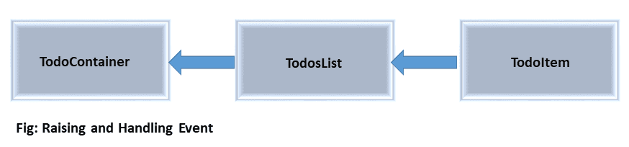
Raising and Handling Events

Slide 51
Starting from the parent component, TodoContainer, add a handler method, handleChange just above the render() method.
handleChange = () => {
console.log("clicked");
};

Slide 52
Start by passing this method to the TodosList component through the props. So, update <TodosList /> so you have:
<TodosList todos={this.state.todos} handleChangeProps={this.handleChange} />

Slide 53
From there, we can pass it to the TodoItem component. Let’s update the <TodoItem /> instance in the TodosList.js file so you have:
<TodoItem
key={todo.id}
todo={todo}
handleChangeProps={this.props.handleChangeProps}
/>

Slide 54
At this point, the handleChange() data can be accessed from the TodoItem component. So, update the onChange handler in the TodoItem component so you have:
onChange={() => this.props.handleChangeProps()}

Slide 55
Then go inside the TodoContainer component and update the handleChange method.
handleChange = (id) => {
console.log("clicked", id);
};

Slide 56
Updating the state using the setState() method
handleChange = id => {
this.setState({
todos: this.state.todos.map(todo => {
if (todo.id === id) {
todo.completed = !todo.completed;
}
return todo;
})
});
};
Notes:
Make sure you update the handleChange method in the TodoContainer component to the code above.

Slide 57
Using the setState updater
this.setState(prevState => ({
todos: prevState.todos.map(todo => {
if (todo.id === id) {
todo.completed = !todo.completed
}
return todo
}),
}))

Slide 58
optimize the handleChange()
this.setState(prevState => {
return {
todos: prevState.todos.map(todo => {
if (todo.id === id) {
return {
...todo,
completed: !todo.completed,
}
}
return todo
}),
}
})
this.setState(prevState => ({
todos: prevState.todos.map(todo => {
if (todo.id === id) {
return {
...todo,
completed: !todo.completed,
}
}
return todo
}),
}))

Slide 59
Deleting items from the todos
Let’s get down. Start by adding a delete button in the TodoItem component.
So, add this button element below the input tag (but before the title):
<button>Delete</button>

Slide 60
As usual, we will enable communication between these components to raise an event. So go inside the TodoContainer component and add a delTodo method above the render().
delTodo = id => {
console.log("deleted", id);
};

Slide 61
Still in the component, update the <TodosList /> to include:
deleteTodoProps={this.delTodo}
<TodosList
todos={this.state.todos}
handleChangeProps={this.handleChange}
deleteTodoProps={this.delTodo}
/>

Slide 62
Save the file and move a level down inside the TodosList component and update the <TodoItem /> so you have:
<TodoItem
key={todo.id}
todo={todo}
handleChangeProps={this.props.handleChangeProps}
deleteTodoProps={this.props.deleteTodoProps}
/>

Slide 63
Finally, back in the TodoItem component. Update the button element to include an onClick event handler that will trigger the delTodo method in the parent component. You should have this:
<button onClick={() => this.props.deleteTodoProps(this.props.todo.id)}>
Delete
</button>

Slide 64
In this case, we only want to return the todos items that do not match the id that will be passed in – i.e., the clicked id. Any id that matches will be deleted. Now update the delTodo method so you have:
delTodo = id => {
this.setState({
todos: [
...this.state.todos.filter(todo => {
return todo.id !== id;
})
]
});
};

Slide 65
Adding a text input field and a submit button
Let’s start by adding the following code inside the empty InputTodo.js file:
import React, { Component } from "react"
class InputTodo extends Component {
render() {
return (
<form>
<input type="text" placeholder="Add Todo..." />
<button>Submit</button>
</form>
)
}
}
export default InputTodo

Slide 66
To use this component in our application, we will import it inside the TodoContainer.js file using this code:
import InputTodo from "./InputTodo"

Slide 67
Then, add <InputTodo /> inside the render() method just below the <Header />. You should have this:
render() {
return (
<div>
<Header />
<InputTodo />
<TodosList
todos={this.state.todos}
handleChangeProps={this.handleChange}
deleteTodoProps={this.delTodo}
/>
</div>
);
}

Slide 68
Handling React form that has more than one text input field
onChange = e => {
this.setState({
[e.target.name]: e.target.value
});
};

Slide 69
render() {
return (
<form>
<input
type="text"
placeholder="Add todo..."
value={this.state.title}
name="title"
onChange={this.onChange}
/>
<button>Submit</button>
</form>
)
}
}
export default InputTodo
import React, { Component } from "react"
class InputTodo extends Component {
state = {
title: "",
}
onChange = e => {
this.setState({
[e.target.name]: e.target.value,
})
}

Slide 70
Update setState()
this.setState({
[e.target.name]: e.target.value,
})

Slide 71
Updating the Todos list
Let's quickly do that. Update the <form> tag in the InputTodo component to include the onSubmit handler.
<form onSubmit={this.handleSubmit}>

Slide 72
Then, add the following code above the render() method and save the file:
handleSubmit = e => {
e.preventDefault();
console.log(this.state.title);
};

Slide 73
As usual, let's start by enabling communication between those components. Starting from the parent component, TodoContainer , add this class method above the render() method:
addTodoItem = title => {
console.log(title);
};

Slide 74
Next, pass this class method to the InputTodo component by updating the <InputTodo /> so you have:
<InputTodo addTodoProps={this.addTodoItem} />

Slide 75
Now, the addTodoItem() method can be accessed through props in the InputTodo component. So, update the handleSubmit method in the InputTodo component so you have:
handleSubmit = e => {
e.preventDefault();
this.props.addTodoProps(this.state.title);
};

Slide 76
Before we move on, let’s clear the input field once we have submitted a todos item for subsequent entry. Simply update the handleSubmit method so you have:
handleSubmit = e => {
e.preventDefault();
this.props.addTodoProps(this.state.title);
this.setState({
title: ""
});
};

Slide 77
Finally, we can update the state. Back to the TodoContainer component, update the addTodoItem() method so you have:
addTodoItem = title => {
const newTodo = {
id: 4,
title: title,
completed: false
};
this.setState({
todos: [...this.state.todos, newTodo]
});
};

Slide 78
Generating random ids for the todos list items
To use these ids in your app, you need to import the UUID in the TodoContainer.js file. So, add this line below the list of the import statements.
import { v4 as uuidv4 } from "uuid";

Slide 79
Then, replace any hardcoded id value with uuidv4(). For instance, instead of having:
id: 1,
id: uuidv4(),

Slide 80
Validating the Form Submission
So, head over to the InputTodo.js file and update the handleSubmit() so you have:
handleSubmit = e => {
e.preventDefault()
if (this.state.title.trim()) {
this.props.addTodoProps(this.state.title)
this.setState({
title: "",
})
} else {
alert("Please write item")
}
}

Slide 81
Thank You!

